Slide 1
The Father, the Son, and the Spirit
2024 Quarter 4 Lesson 11
John 15, 16, 17

Slide 2
EGW “Christ’s Object in Coming to the world”
Signs of the Times, June 27, 1895
The great object that brought Christ to the earth was to reveal the Father… But who that is not infinite can understand the infinite? Christ declares, “No man knoweth the Father but the Son, and he to whomsoever the Son shall reveal him.”

Slide 3
EGW “Christ’s Object in Coming to the world”
Signs of the Times, June 27, 1895
The greatness of God cannot be measured or comprehended. And that doctrine that denies the absolute Godhead of Jesus Christ, denies also the Godhead of the Father; for no man knoweth the Son but the Father.

Slide 4
EGW “Christ’s Object in Coming to the world”
Signs of the Times, June 27, 1895
The mightiest created intelligence cannot grasp divinity. The principalities and powers of heaven are overwhelmed with the vastness of the theme of Christ's character and the mystery of the union of divinity and humanity.

Slide 5
EGW “Testimonies for the Church Containing Messages of Warning and Instruction to Seventh-day Adventists” P. 62
I am instructed to say, The sentiments of those who are searching for advanced scientific ideas are not to be trusted. Such representations as the following are made: “The Father is as the light invisible; the Son is as the light embodied; the Spirit is the light shed abroad.”

Slide 6
EGW “Testimonies for the Church Containing Messages of Warning and Instruction to Seventh-day Adventists” P. 62
“The Father is like the dew, invisible vapor; the Son is like the dew gathered in beauteous form; the Spirit is like the dew fallen to the seat of life.” Another representation: “The Father is like the invisible vapor; the Son is like the leaden cloud; the Spirit is rain fallen and working in refreshing power.”

Slide 7
EGW “Testimonies for the Church Containing Messages of Warning and Instruction to Seventh-day Adventists” P. 62
All these spiritualistic representations are simply nothingness. They are imperfect, untrue. They weaken and diminish the Majesty which no earthly likeness can be compared to.

Slide 8
EGW “Testimonies for the Church Containing Messages of Warning and Instruction to Seventh-day Adventists” P. 62
God can not be compared with the things His hands have made. These are mere earthly things, suffering under the curse of God because of the sins of man. The Father can not be described by the things of earth.

Slide 9
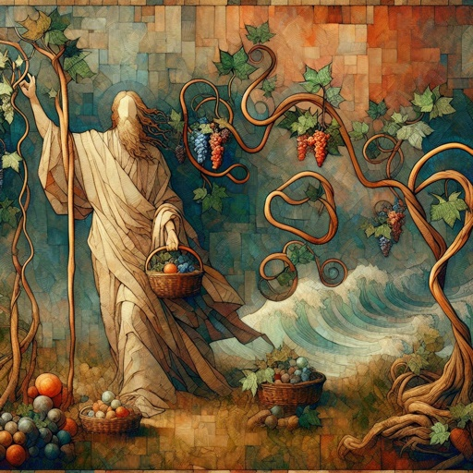
The Point: Interconnectedness (John 15:1)
I am the true vine, and my Father is the husbandman.

Slide 10
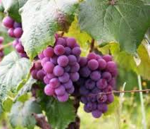
The Point: Interconnectedness (John 15:2)
Every branch in me that beareth not fruit he taketh away: and every branch that beareth fruit, he purgeth it, that it may bring forth more fruit.

Slide 11

The Point: Interconnectedness (John 15:3)
Now ye are clean through the word which I have spoken unto you.

Slide 12
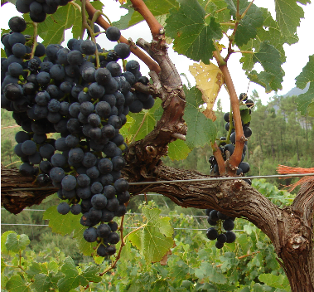
The Point: Interconnectedness (John 15:4)
Abide in me, and I in you. As the branch cannot bear fruit of itself, except it abide in the vine; no more can ye, except ye abide in me.

Slide 13
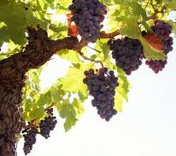
The Point: Interconnectedness (John 15:5)
I am the vine, ye are the branches: He that abideth in me, and I in him, the same bringeth forth much fruit: for without me ye can do nothing.

Slide 14
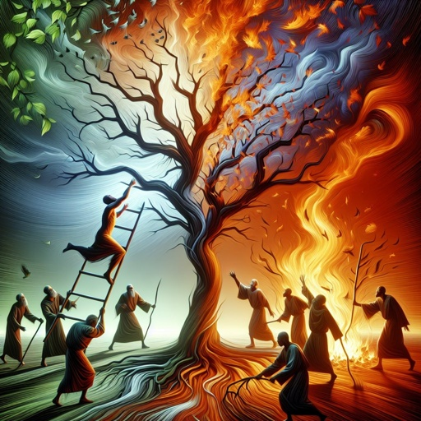
The Point: Interconnectedness (John 15:6)
If a man abide not in me, he is cast forth as a branch, and is withered; and men gather them, and cast them into the fire, and they are burned.

Slide 15

The Point: Interconnectedness (John 15:7)
If ye abide in me, and my words abide in you, ye shall ask what ye will, and it shall be done unto you.

Slide 16
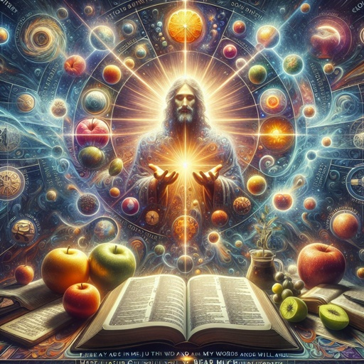
The Point: Interconnectedness (John 15:8)
Herein is my Father glorified, that ye bear much fruit; so shall ye be my disciples.

Slide 17
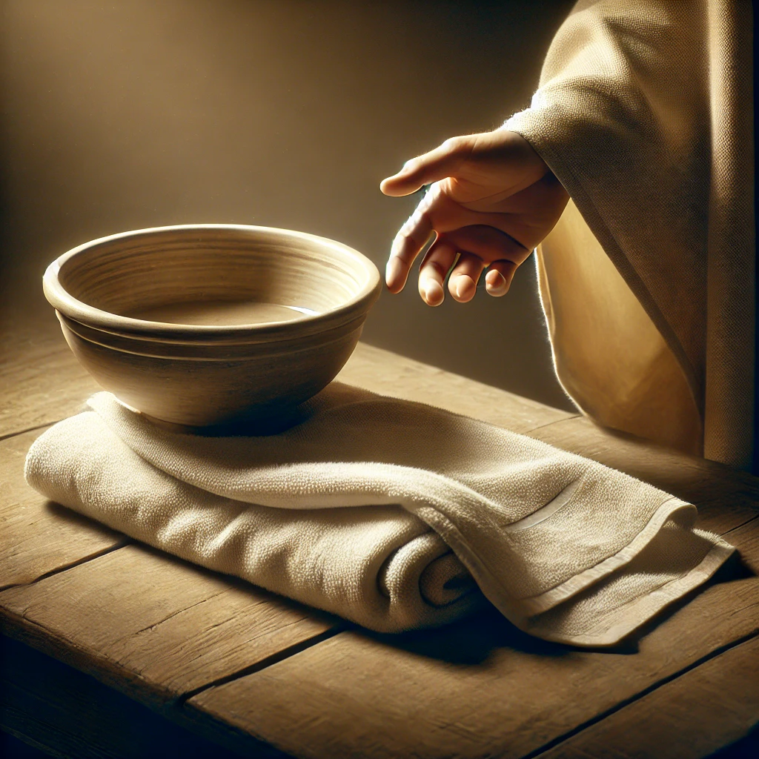
The Point: Interconnectedness (John 15:9)
As the Father hath loved me, so have I loved you: continue ye in my love.

Slide 18
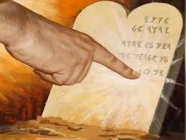
The Point: Interconnectedness (John 15:10)
If ye keep my commandments, ye shall abide in my love; even as I have kept my Father's commandments, and abide in his love.

Slide 19
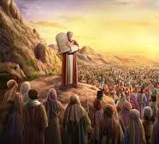
The Point: Interconnectedness (John 15:11)
These things have I spoken unto you, that my joy might remain in you, and that your joy might be full.

Slide 20

The Warning: Sympathies (John 15:18)
If the world hate you, ye know that it hated me before it hated you.

Slide 21

The Warning: Sympathies (John 15:19)
If ye were of the world, the world would love his own: but because ye are not of the world, but I have chosen you out of the world, therefore the world hateth you.

Slide 22

The Warning: Sympathies (John 15:20)
Remember the word that I said unto you, The servant is not greater than his lord. If they have persecuted me, they will also persecute you; if they have kept my saying, they will keep yours also.

Slide 23
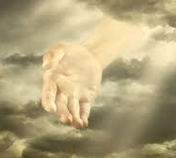
The Warning: Sympathies (John 15:21)
But all these things will they do unto you for my name's sake, because they know not him that sent me.

Slide 24

The Warning: Sympathies (John 15:22)
If I had not come and spoken unto them, they had not had sin: but now they have no cloak for their sin.

Slide 25
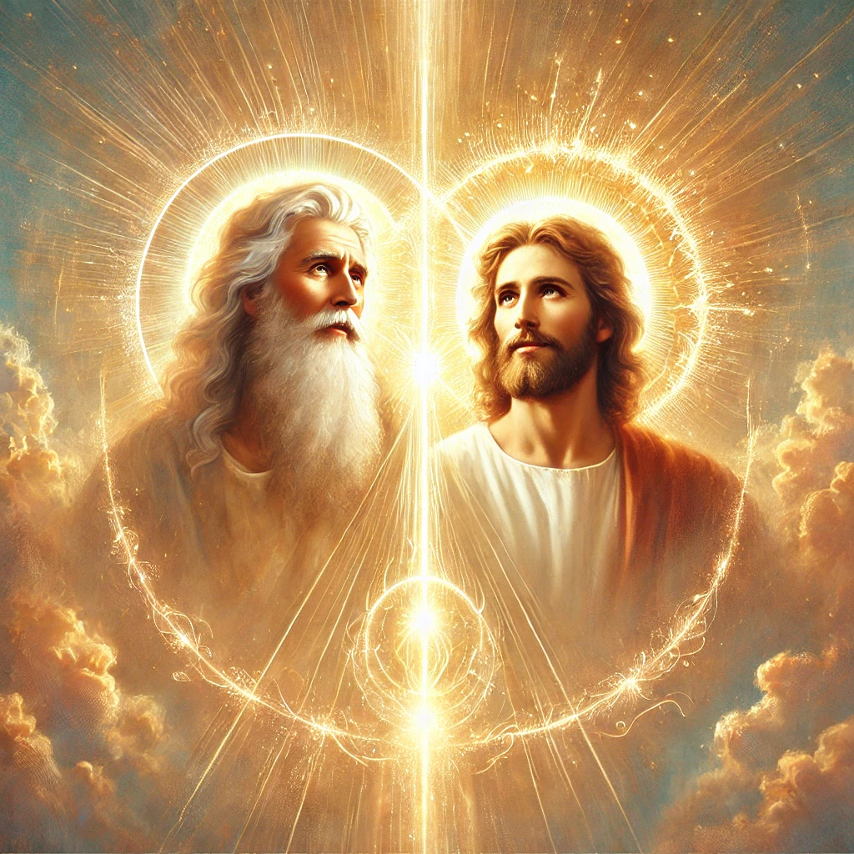
The Warning: Sympathies (John 15:23)
He that hateth me hateth my Father also.

Slide 26
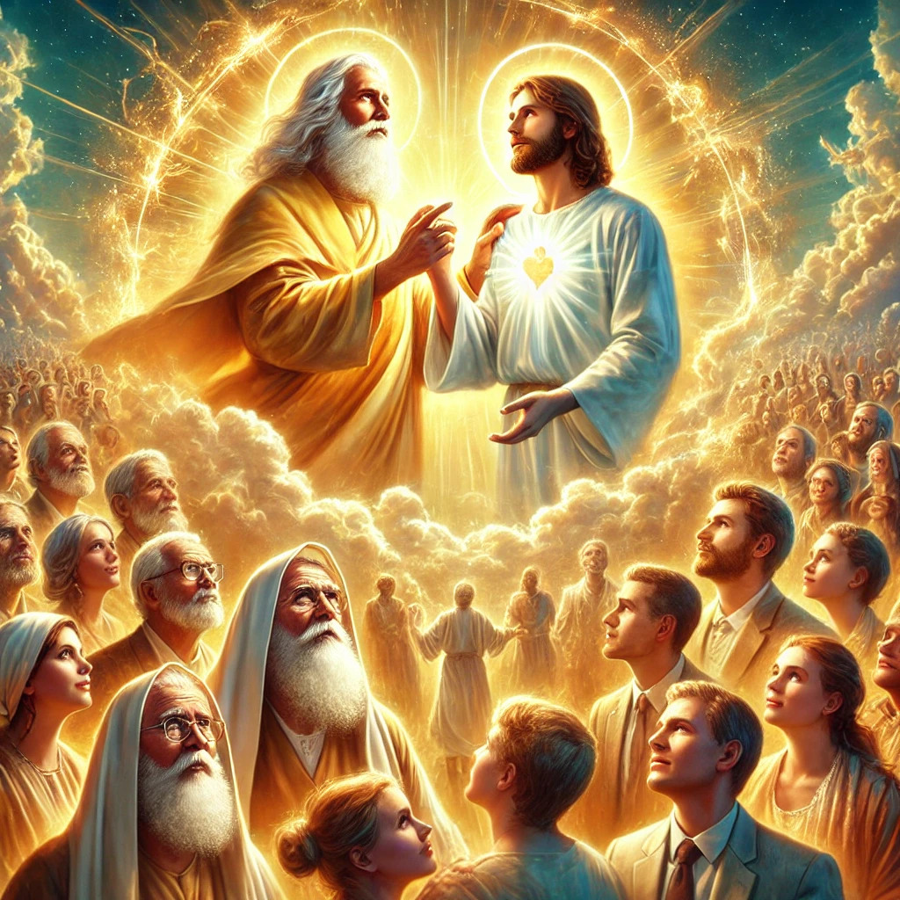
The Warning: Sympathies (John 15:24)
If I had not done among them the works which none other man did, they had not had sin: but now have they both seen and hated both me and my Father.

Slide 27
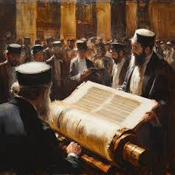
The Warning: Sympathies (John 15:25)
But this cometh to pass, that the word might be fulfilled that is written in their law, They hated me without a cause.

Slide 28
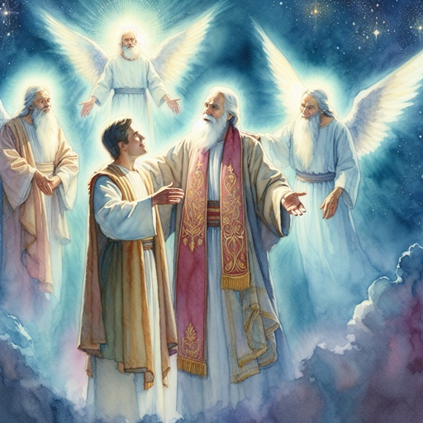
The Coming Comforter
(John 15:26)
But when the Comforter is come, whom I will send unto you from the Father, even the Spirit of truth, which proceedeth from the Father, he shall testify of me.

Slide 29
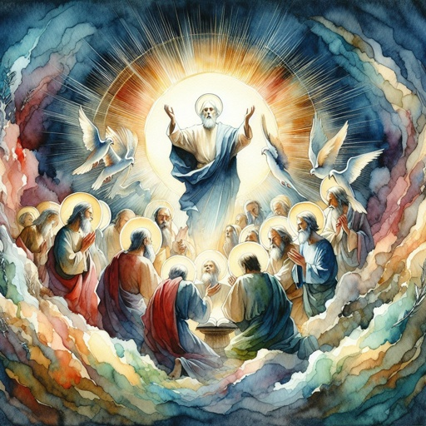
The Coming Comforter (John 16:5)
But now I go my way to him that sent me; and none of you asketh me, Whither goest thou?

Slide 30
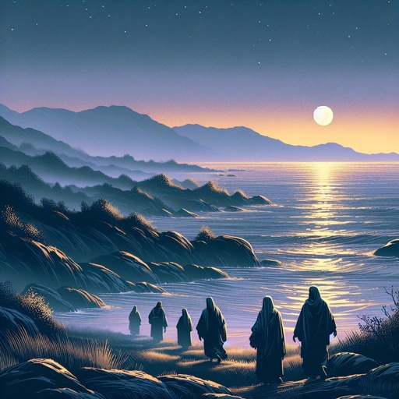
The Coming Comforter
(John 16:6)
But because I have said these things unto you, sorrow hath filled your heart.

Slide 31

The Coming Comforter
(John 16:7)
Nevertheless I tell you the truth; It is expedient for you that I go away: for if I go not away, the Comforter will not come unto you; but if I depart, I will send him unto you.

Slide 32

The Coming Comforter
(John 16:8)
And when he is come, he will reprove the world of sin, and of righteousness, and of judgment:

Slide 33

he will Reprove
The word translated “reprove” is the Greek elegcho, “to convict.” It’s translated as “convict in John 8:9. In John 8:46 it is translated “convince” (cf. 1 Cor. 14:24; Titus 1 :9; James 2:9), but “convict” would be preferable. In Luke 3:19; Eph. 5:11, 13; 2 Tim. 4:2 elegcho is translated “reprove,” and in 1 Tim. 5:20; Titus 1:13; Heb. 12:5; Rev. 3:19 “rebuke.”

Slide 34
he will reprove the world of sin
The day of Pentecost, the day when the gift of the Spirit was bestowed, provided a striking exhibit of this aspect of the Spirit’s work. Those who heard Peter’s address were “pricked in their heart” (Acts 2:37). One of the first evidences of the operation of the Holy Spirit is the deep conviction that one is a sinner.

Slide 35

The Coming Comforter
(John 16:9)
Of sin, because they believe not on me;

Slide 36
he will reprove the world of Righteousness
Not only does the Spirit expose sin; He convicts of positive righteousness. He urges men to accept the righteousness of Christ, both the imputed (Rom. 10:3-10) and the imparted (Gal. 2:20; Phil. 2:13).

Slide 37

The Coming Comforter
(John 16:10)
Of righteousness, because I go to my Father, and ye see me no more;

Slide 38
he will reprove the world of Judgement
Jesus also warned men of the judgment to come. None can escape the judgment; it is as sure as death (Heb. 9:27). Though fear of judgment is not to be the prime motive of doing right, it is, nevertheless, a powerful agency in awakening sin-darkened minds.

Slide 39

The Coming Comforter
(John 16:11)
Of judgment, because the prince of this world is judged.

Slide 40
Spirit of Truth
The Desire of Ages p. 671
The Comforter is called ‘the Spirit of truth.’ His work is to define and maintain the truth. He first dwells in the heart as the Spirit of truth, and thus He becomes the Comforter. There is comfort and peace in the truth, but no real peace or comfort can be found in falsehood. It is through false theories and traditions that Satan gains his power over the mind.

Slide 41
Spirit of Truth
The Desire of Ages p. 671
By directing men to false standards, he misshapes the character. Through the Scriptures the Holy Spirit speaks to the mind, and impresses truth upon the heart. Thus He exposes error, and expels it from the soul. It is by the Spirit of truth, working through the word of God, that Christ subdues His chosen people to Himself.

Slide 42
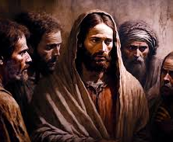
One God (John 16:12)
I have yet many things to say unto you, but ye cannot bear them now.

Slide 43
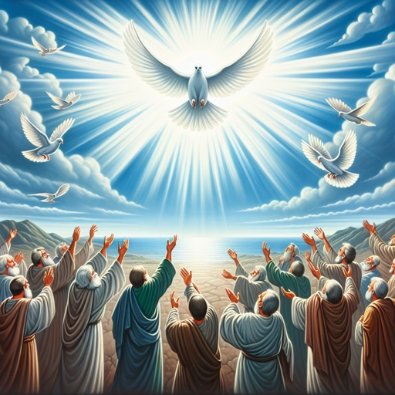
One God (John 16:13)
Howbeit when he, the Spirit of truth, is come, he will guide you into all truth: for he shall not speak of himself; but whatsoever he shall hear, that shall he speak: and he will shew you things to come.

Slide 44
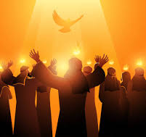
One God (John 16:14)
He shall glorify me: for he shall receive of mine, and shall shew it unto you.

Slide 45
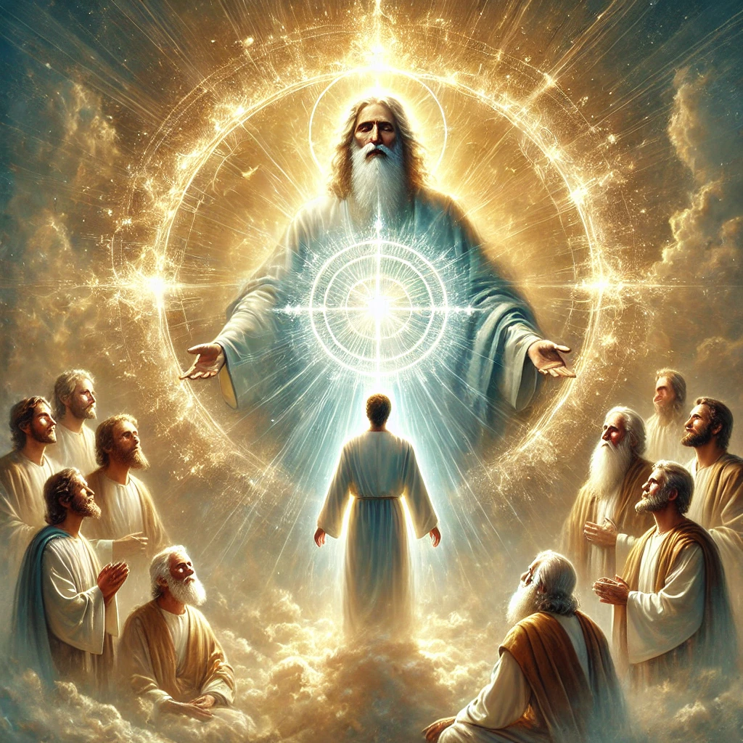
One God (John 16:15)
All things that the Father hath are mine: therefore said I, that he shall take of mine, and shall shew it unto you.

Slide 46
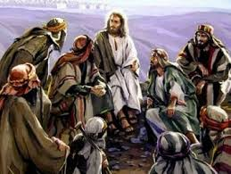
Interconnectedness
(John 16:22)
And ye now therefore have sorrow: but I will see you again, and your heart shall rejoice, and your joy no man taketh from you.

Slide 47
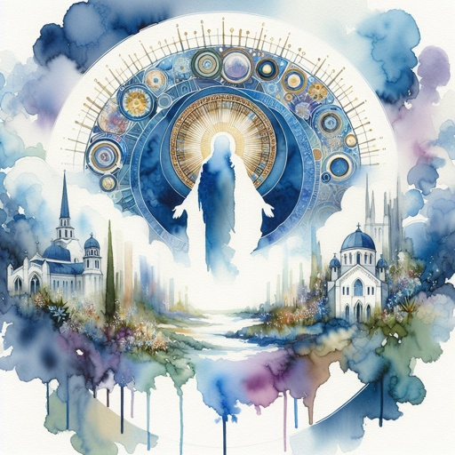
Interconnectedness
(John 16:23)
And in that day ye shall ask me nothing. Verily, verily, I say unto you, Whatsoever ye shall ask the Father in my name, he will give it you.

Slide 48
To ASK or NOT to Ask
SDABC
The word “ask” is used twice in this verse, in the first instance from erotao, in the second from aiteo. Erotao generally means to ask a question, in contrast to aiteo, which means to ask for something. In this case Jesus is informing the disciples that in the day (of the gift of the Holy Spirit) there will be no need for questions, for the Spirit would teach them all things.

Slide 49
Interconnectedness
(John 16:23)
And in that day ye shall ask me nothing. Verily, verily, I say unto you, Whatsoever ye shall ask the Father in my name, he will give it you.

Slide 50
To ASK or NOT to Ask
SDABC
However, John also uses erotao in the sense of asking for something. If John intended the same meaning here, then the contrast is between “ask me” and “ask the Father.” The disciples would no longer have Jesus’ bodily presence among them, but they could freely petition the Father in the name of Jesus, fully assured that their requests would be granted.

Slide 51
Interconnectedness
(John 16:23)
And in that day ye shall ask me nothing. Verily, verily, I say unto you, Whatsoever ye shall ask the Father in my name, he will give it you.

Slide 52
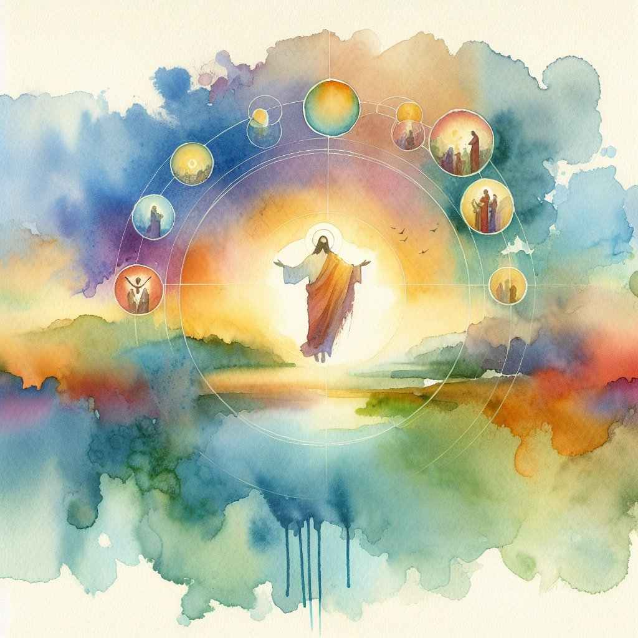
Interconnectedness
(John 16:24)
Hitherto have ye asked nothing in my name: ask, and ye shall receive, that your joy may be full.

Slide 53
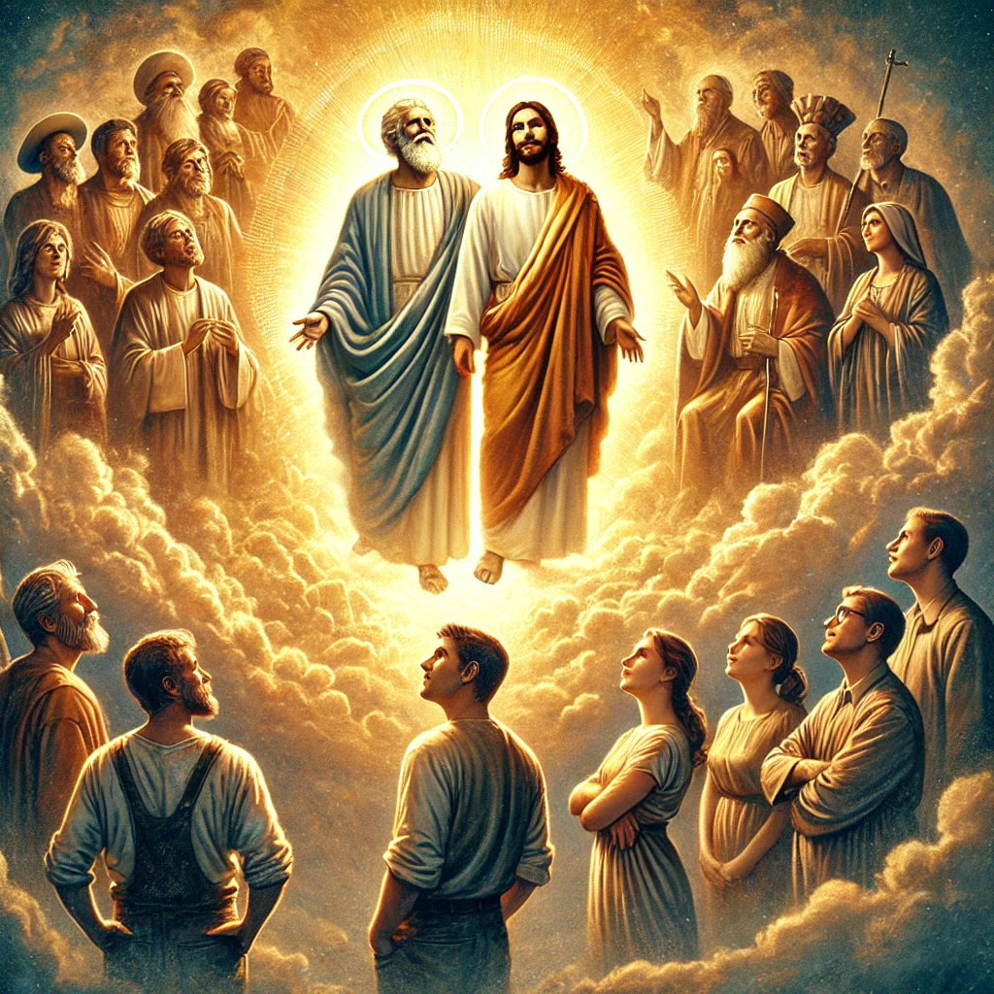
Interconnectedness
(John 16:25)
These things have I spoken unto you in proverbs: but the time cometh, when I shall no more speak unto you in proverbs, but I shall shew you plainly of the Father.

Slide 54
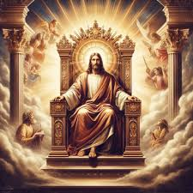
Interconnectedness
(John 16:26)
At that day ye shall ask in my name: and I say not unto you, that I will pray the Father for you:

Slide 55
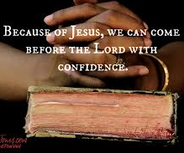
Interconnectedness
(John 16:27)
For the Father himself loveth you, because ye have loved me, and have believed that I came out from God.

Slide 56
Direct Connection
SDABC
Christ’s intercession was not to overcome any reluctance or unwillingness on the part of the Father to hear the prayers of the saints. The Father Himself loved the disciples and was as willing to answer prayer as was the Son. The point of illustration in representing Jesus as an intercessor (Heb. 7:25) is that only by means of the infinite sacrifice of the Son is it possible for either the Father or the Son to extend fullness of blessing to the petitioner.

Slide 57
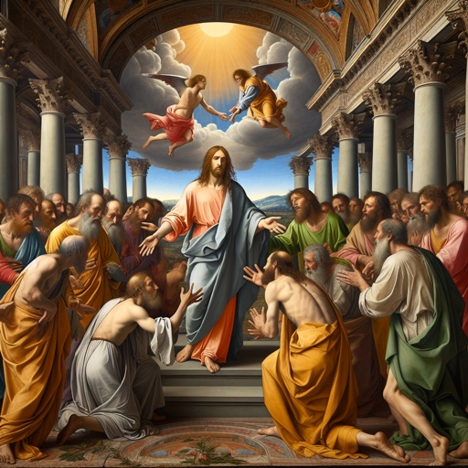
Interconnectedness
(John 16:28)
I came forth from the Father, and am come into the world: again, I leave the world, and go to the Father.

Slide 58
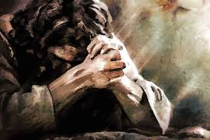
Jesus Prayer: John 17

Slide 59
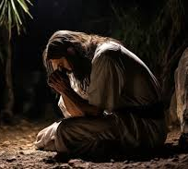
Prayer for Oneness (John 17:4)
I have glorified thee on the earth: I have finished the work which thou gavest me to do.

Slide 60
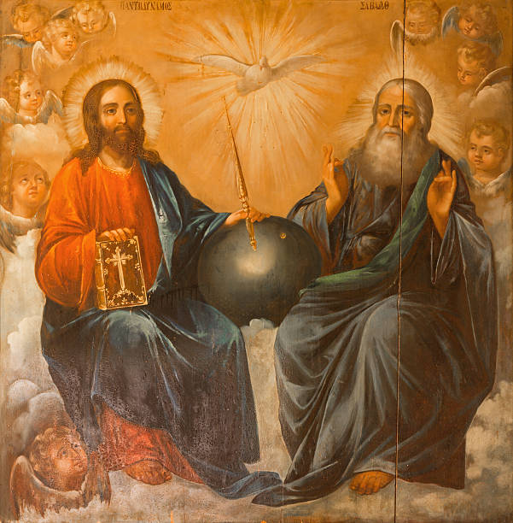
Prayer for Oneness (John 17:5)
And now, O Father, glorify thou me with thine own self with the glory which I had with thee before the world was.

Slide 61
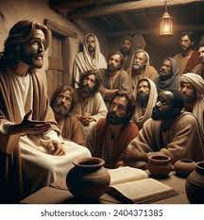
Prayer for Oneness (John 17:6)
I have manifested thy name unto the men which thou gavest me out of the world: thine they were, and thou gavest them me; and they have kept thy word.

Slide 62
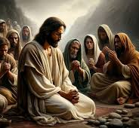
Prayer for Oneness (John 17:7)
Now they have known that all things whatsoever thou hast given me are of thee.

Slide 63
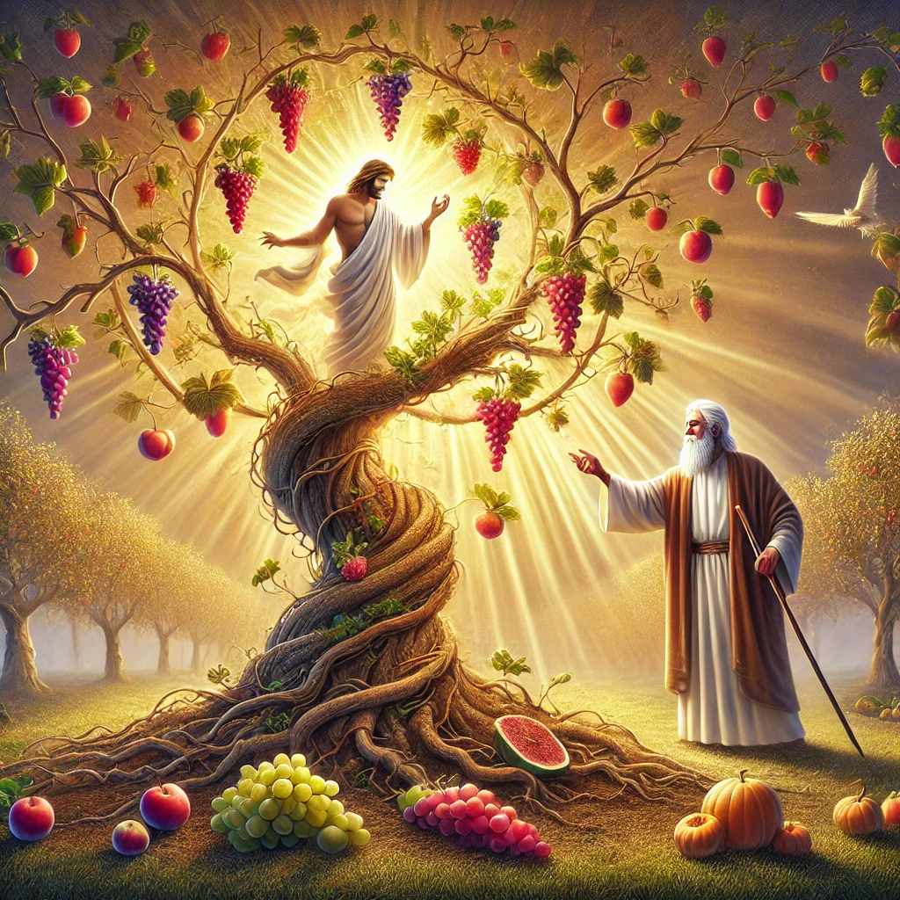
Prayer for Oneness (John 17:8)
For I have given unto them the words which thou gavest me; and they have received them, and have known surely that I came out from thee, and they have believed that thou didst send me.

Slide 64
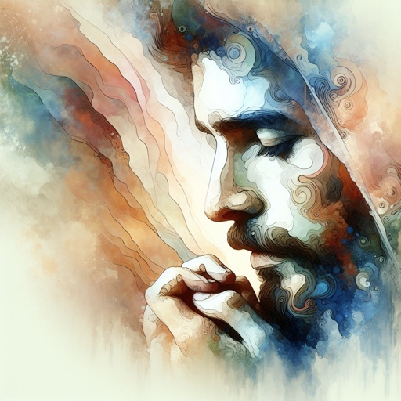
Prayer for Oneness (John 17:9)
I pray for them: I pray not for the world, but for them which thou hast given me; for they are thine.

Slide 65
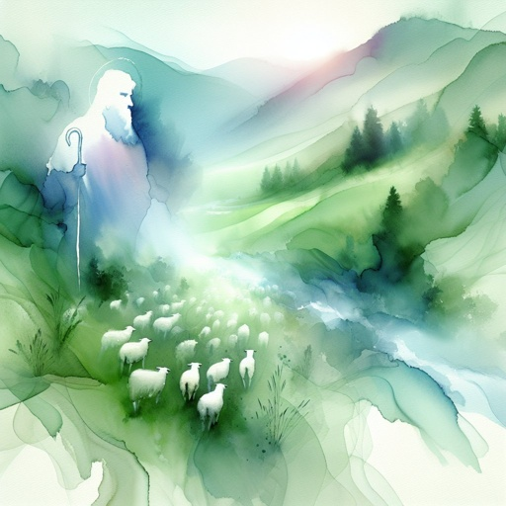
Prayer for Oneness (John 17:10)
And all mine are thine, and thine are mine; and I am glorified in them.

Slide 66
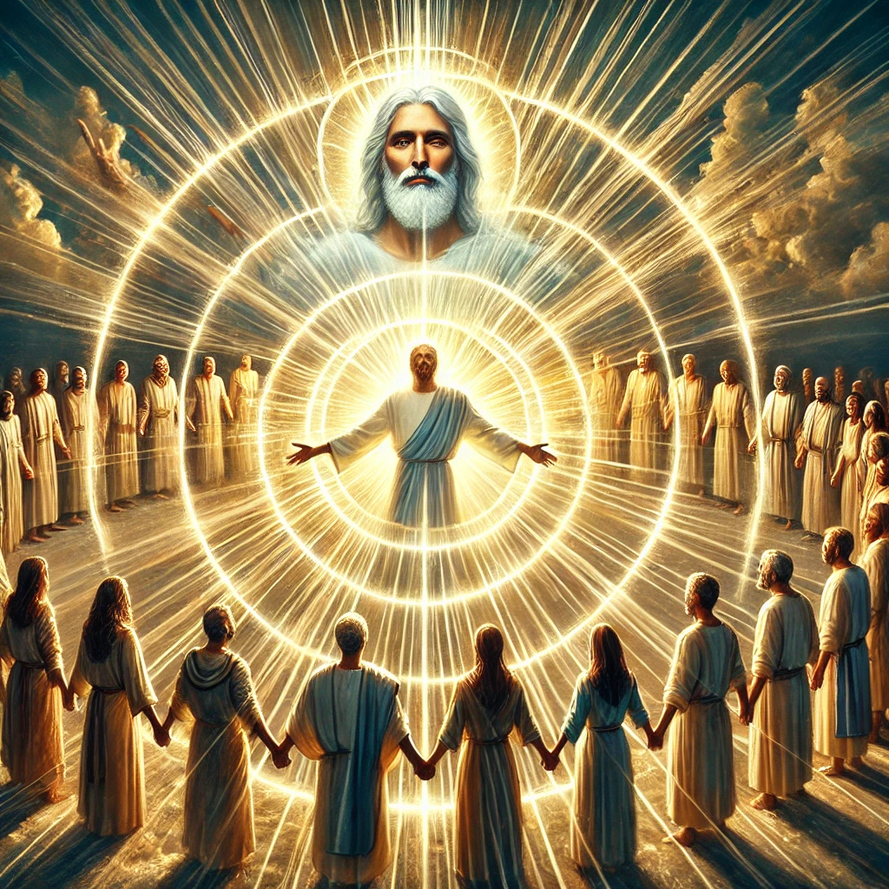
Prayer for Oneness (John 17:11)
And now I am no more in the world, but these are in the world, and I come to thee. Holy Father, keep through thine own name those whom thou hast given me, that they may be one, as we are.

Slide 67
But Jesus’ followers don’t just sit around In Happy Amity being One…
There’s a Mission to Complete!

Slide 68
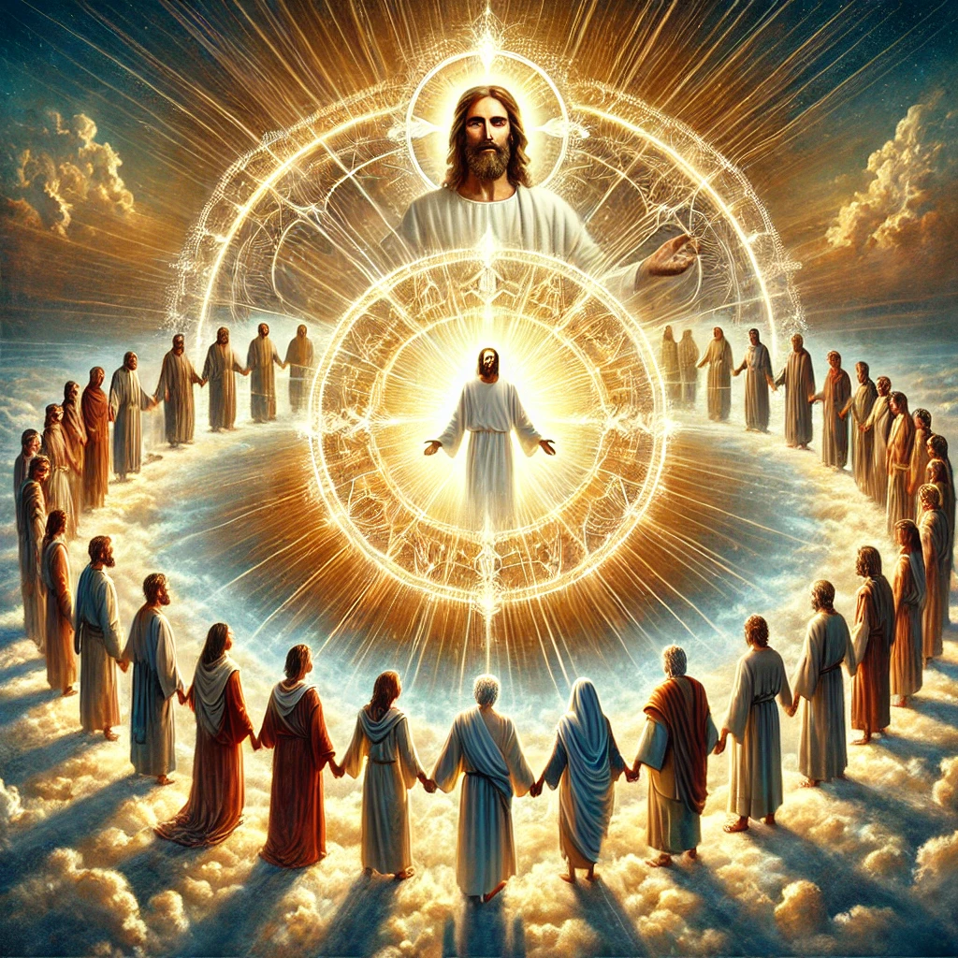
The Mission (John 17:14)
I have given them thy word; and the world hath hated them, because they are not of the world, even as I am not of the world.

Slide 69
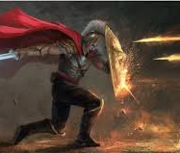
The Mission (John 17:15)
I pray not that thou shouldest take them out of the world, but that thou shouldest keep them from the evil.

Slide 70
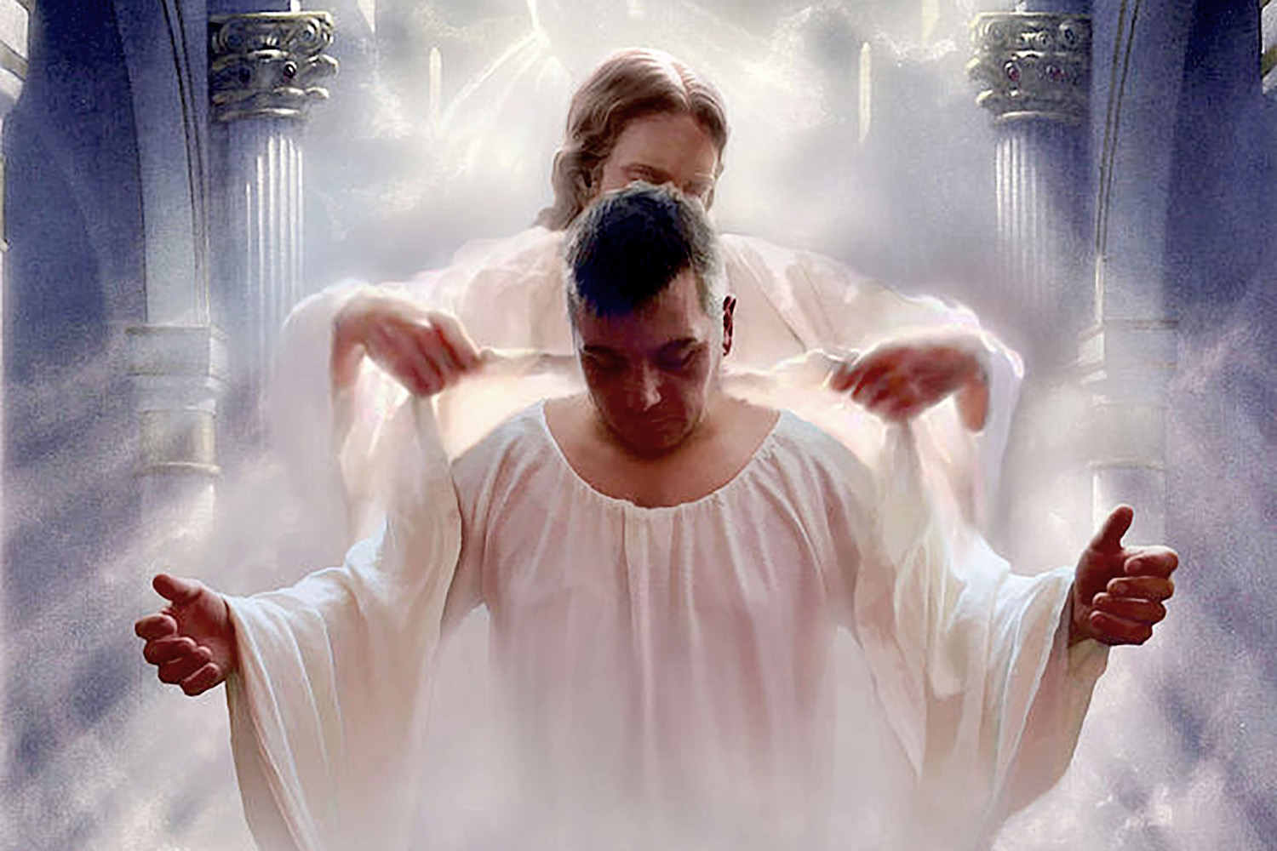
The Mission (John 17:16)
They are not of the world, even as I am not of the world.

Slide 71

The Mission (John 17:17)
Sanctify them through thy truth: thy word is truth.

Slide 72

The Mission (John 17:18)
As thou hast sent me into the world, even so have I also sent them into the world.

Slide 73

The Mission (John 17:19)
And for their sakes I sanctify myself, that they also might be sanctified through the truth.

Slide 74
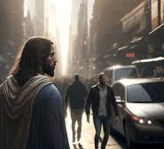
Prayer for Us (John 17:20)
Neither pray I for these alone, but for them also which shall believe on me through their word;

Slide 75

Prayer for Us (John 17:21)
That they all may be one; as thou, Father, art in me, and I in thee, that they also may be one in us: that the world may believe that thou hast sent me.

Slide 76
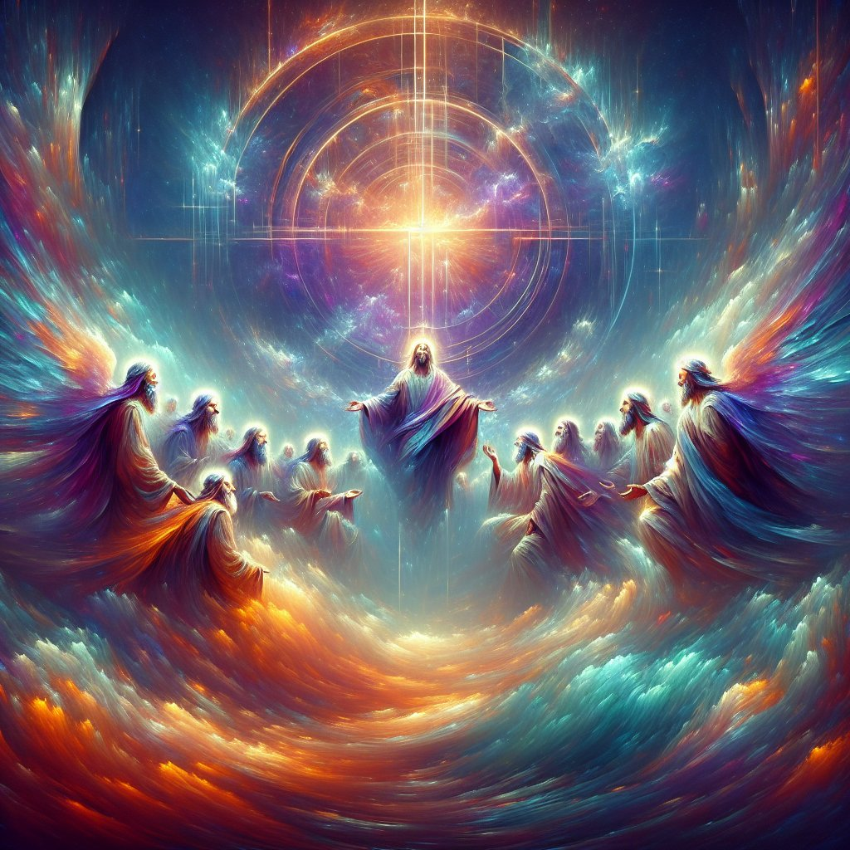
Prayer for Us (John 17:22)
And the glory which thou gavest me I have given them; that they may be one, even as we are one:

Slide 77

Prayer for Us (John 17:23)
I in them, and thou in me, that they may be made perfect in one; and that the world may know that thou hast sent me, and hast loved them, as thou hast loved me.

Slide 78
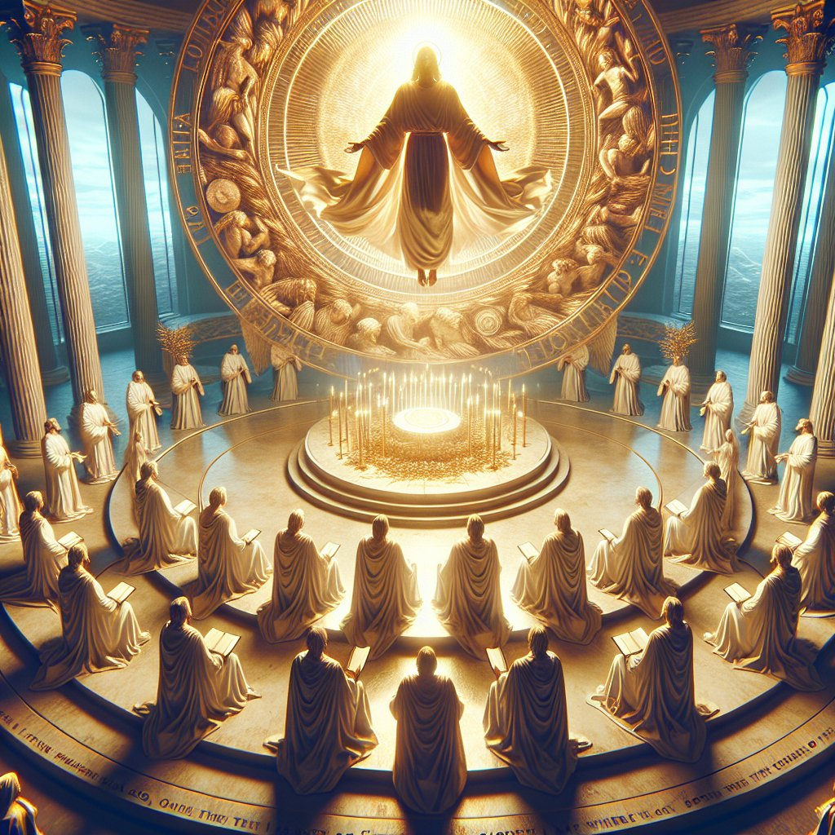
Prayer for Us (John 17:24)
Father, I will that they also, whom thou hast given me, be with me where I am; that they may behold my glory, which thou hast given me: for thou lovedst me before the foundation of the world.

Slide 79
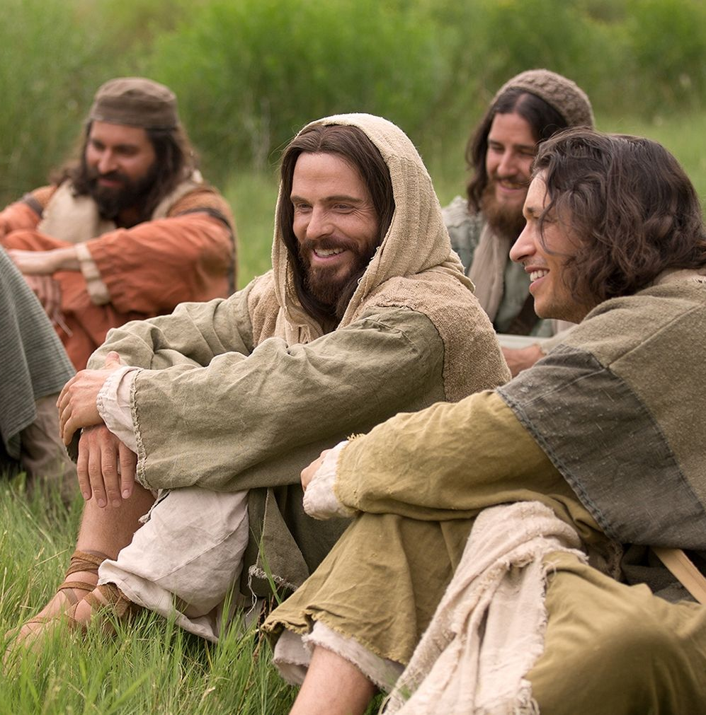
Prayer for Us (John 17:25)
O righteous Father, the world hath not known thee: but I have known thee, and these have known that thou hast sent me.

Slide 80

Prayer for Us (John 17:26)
And I have declared unto them thy name, and will declare it: that the love wherewith thou hast loved me may be in them, and I in them.

Slide 81

John 16:33
³³ These things I have spoken unto you, that in me ye might have peace. In the world ye shall have tribulation: but be of good cheer; I have overcome the world.

Slide 82
Thanks for listening… Have a Happy Sabbath!!

